Slide 1


High throughput sequencing datasets are ripe for misinterpretation – why analyses to date could be wildly wrong
Greg Gloor
The University of Western Ontario, London, Canada; ggloor@uwo.ca

Slide 2

Best quote ever!?
There are known knowns. These are things we know that we know.
There are known unknowns. That is to say, there are things that we know we don't know.
But there are also unknown unknowns. There are things we don't know we don't know.
There are unknown knows: That is, there are also things we think we know that we don’t know
Donald Rumsfeld

Slide 3
One category that he missed
There are known knowns. These are things we know that we know.
There are known unknowns. That is to say, there are things that we know we don't know.
But there are also unknown unknowns. There are things we don't know we don't know.
There are unknown knowns: That is, there are also things we think we know that we don’t know

Slide 4
I contend that
We believe high sequencing depth equates with a large amount of data
We believe that we can extract information from datasets that break the assumptions of statistics
We believe that someone else’s assumptions about the data are correct
Many of the HTS experiments that we accept as dogma may have serious flaws

Slide 5
16S rRNA gene sequencing
By definition (almost) a species in bacteria is a 16S rRNA gene sequence
Amplify conserved sub-regions in 16S rRNA gene
Sequence intervening variable region
Most common now is V4 (EMB), HMP used V1-V2
Tables of numbers of reads per sample
Yarza, Nat. Rev. Micro 2014 12:635

Slide 6
Where does HTS data come from?
DNA or RNA fragments from the environment
A random sample used to make a library
A random sample of the library is sequenced and mapped
This generates a table of counts per feature (OTU, gene) in each sample
The number of reads is determined by the machine!
Notes:
Many more fragments than we can count

Slide 7
Hanage’s 5 questions
Can experiments detect differences that matter?
Does the study show causation or just correlation?
What is the mechanism?
How much do experiments reflect reality?
Could anything else explain the results?
248 | NATURE | VOL 512 | 21 AUGUST 2014

Slide 8
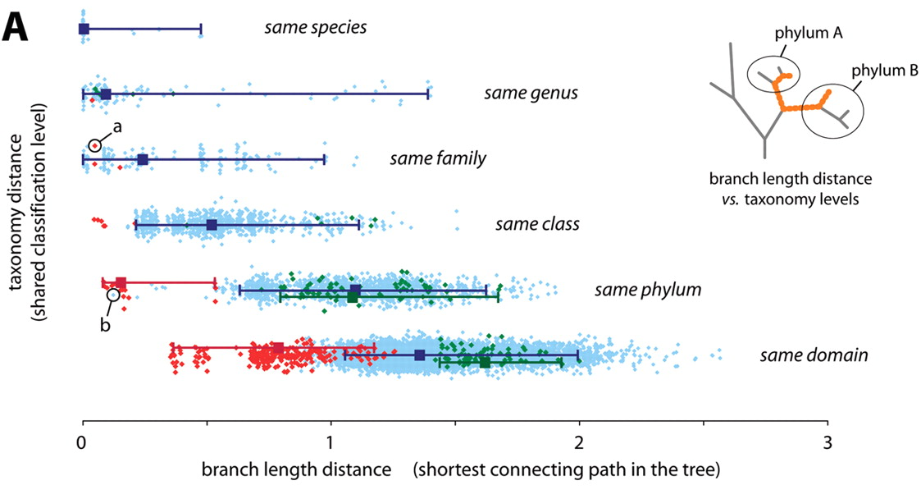
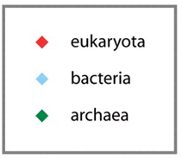
Differences that matter?
Humans and oysters are about as distinct as are different microbial genera
What do comparisons at the genus, family, phylum level mean for microbes?
Different strains can have completely opposite characteristics
What does this mean for imputation methods?
(eg. PICRUSt)
Cicacarlli et. al, 2006, Science 311:1283

Slide 9
Hanage’s 5 questions
Can experiments detect differences that matter?
Does the study show causation or just correlation?
Cross-sectional study designs dominate
What is the mechanism?
How much do experiments reflect reality?
Could anything else explain the results?

Slide 10
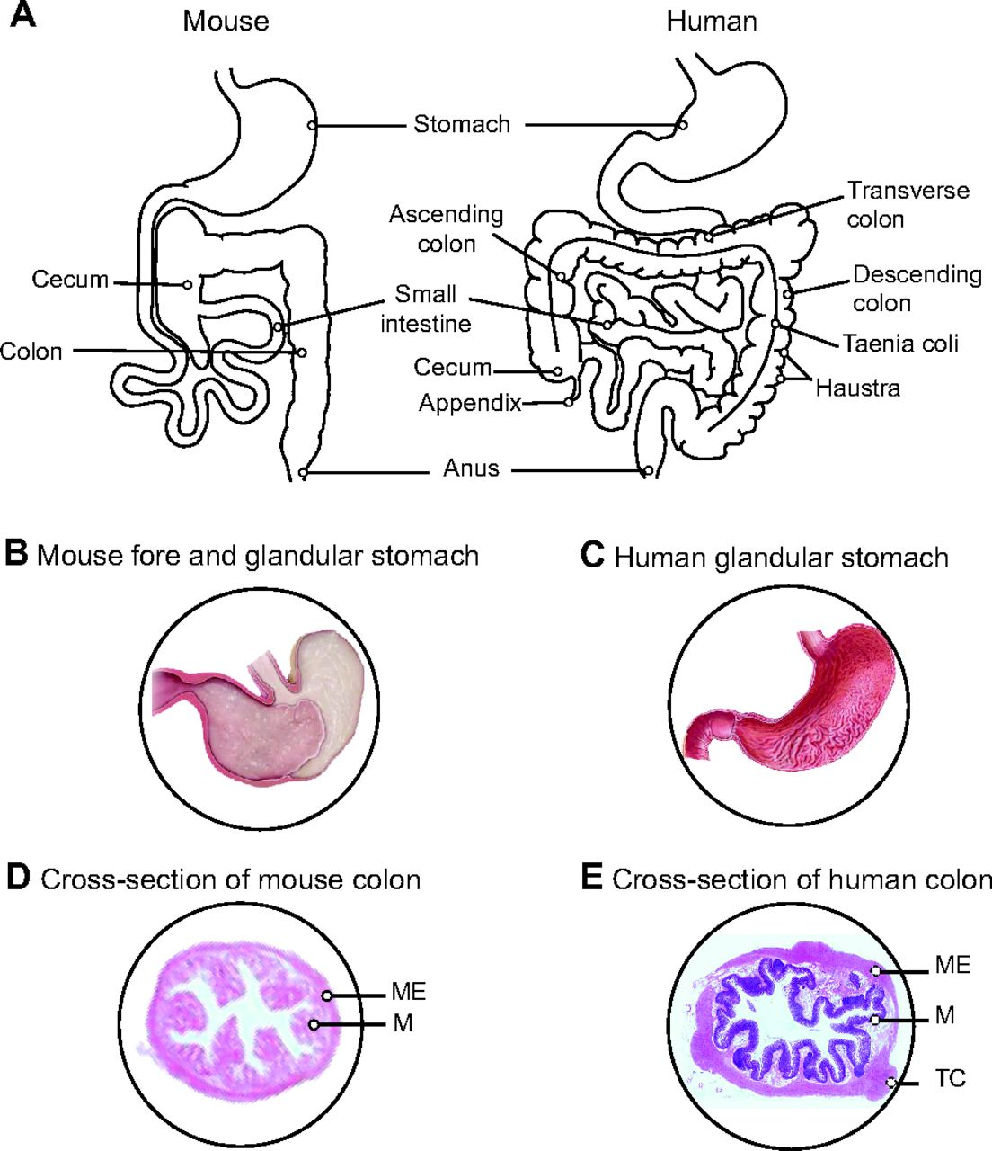
Mechanism/Reality
Mouse and human anatomy, physiology and microbiomes differ
Some notable successes, some questionable experiments
Effect of inbred mice on the results?
Results likely will not replicate across time, mouse strains, or colonies
Nguyen, Vieira-Silva, et al. Dis Models Mech 2015

Slide 11
Hanage’s 5 questions
Can experiments detect differences that matter?
Does the study show causation or just correlation?
What is the mechanism?
How much do experiments reflect reality?
Could anything else explain the results? Yes!

Slide 12
Sources of variability - MBQC
Sample collection (metadata, storage)
Make DNA (method, amount, contaminants)
PCR amplify in multiplex (contaminate, error)
Sequence (error, instrument)
Demultiplex (error, method)
Enumerate the reads per OTU (method)
Statistical analysis (assumptions, method)

Slide 13
Controlling for experimental variability
Standardize
Your standards will differ from others’
Control
No DNA, spike-in, single organism
Randomize control samples
Have one person oversee and understand all aspects of the experiment
Cannot treat the experiment and analysis as a series of black boxes passed from one person to another
May require heroic efforts

Slide 14
Controlling for experimental variability
Standardize
Your standards will differ from others’
Control
No DNA, spike-in, single organism
Randomize control samples
Have one person know the entire experiment
May require heroic efforts
Even so …

Slide 15
We have a difference!
Human Gut, 16S rRNA gene sequence, Healthy vs nonalcoholic steatohepatitis

Slide 16
Do we have a difference?
Human Gut, 16S rRNA gene sequence, Healthy vs nonalcoholic steatohepatitis

Slide 17
What causes the difference?
Human Gut, 16S rRNA gene sequence, Healthy vs nonalcoholic steatohepatitis

Slide 18

Sequencing data are high-dimensional
Therefore statistical analyses can be wildly optimistic
Sequencing data are sparse
Therefore we need to estimate many of our values
Sequencing data are compositional
Therefore everything correlates with everything
Most of us are unaware of the problems

Slide 19
The biggest problem is -
Sequencing data are high-dimensional
Therefore statistical analyses can be wildly optimistic
Sequencing data are sparse
Therefore we need to estimate many of our values
Sequencing data are compositional
everything correlates with everything
Most of us are unaware of the problems

Slide 20
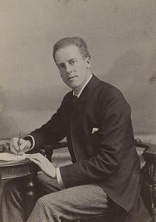
Karl Pearson - 1896
From the above examples it will be seen that the method which judges of the intensity of organic correlation by the reduction of all absolute measures to indices, the denominators of which are some one absolute measurement, is not free from obscurity; for this method would give the major portion of the observed index correlation had the parts of the animal been thrown together at random, i.e., if there were no organic correlation at all
In other words – these datasets are not what they seem to be, and spurious correlation is a major unappreciated problem whenever a ratio is involved

Slide 21

Assumption: The total number of molecules examined is the same between samples
Bacterial load is not constant between environments
The total RNA level is not constant between growth states, tissues or organisms
Compositional data are ratio datasets
Either imposed or by design (Aitchison, 1986)
Proportions, %, ppm, etc

Slide 22
reality: The total number of molecules examined is not the same between samples
Bacterial load is not constant between environments
The total RNA level is not constant between growth states, tissues or organisms
Compositional data are ratio datasets
Either imposed or by design (Aitchison, 1986)
Proportions, %, ppm, etc

Slide 23
Compositional data are ratio datasets
Either imposed or by design (Aitchison, 1986)
Proportions, %, ppm, etc
Recall that the sequencer imposes an arbitrary limit on the number of reads obtained
Thus: CoDa!

Slide 24
One problem is geometrical
We are bounded by real numbers that must be positive
A value of 0 represents an infinity on one or more axes
Notes:
Many more fragments than we can count

Slide 25
And non-linearity
Here we can see the non-linear relationship between what we want to examine, and what we can examine!
x =[x₁,x₂ … x_{n}] p =[p₁,p₂ … p_{n}]
Aitchison, 1986, The statistical analysis of compositional data
Notes:
Many more fragments than we can count

Slide 26
And negative correlations
Here we can see the negative correlation bias – if one thing goes up, something else has to go down
x =[x₁,x₂ … x_{n}] p =[p₁,p₂ … p_{n}]
Aitchison, 1986, The statistical analysis of compositional data
Notes:
Many more fragments than we can count

Slide 27
CLR transformation
x =[x₁,x₂ … x_{n}] p =[p₁,p₂ … p_{n}] clr(x) = [log2(x₁/gx),
log2(x₂/gx) … log2(x_{n}/gx)]
(gx is the geometric mean of vector)
Aitchison, 1986, The statistical analysis of compositional data
Notes:
Many more fragments than we can count

Slide 28
Requirements for analysis
The three rules of CoDa analysis
Conclusions must be scale invariant
Conclusions must be permutation invariant
Conclusions must be subcompositionally coherent
We can only examine ratios between components!
Andrew’s rule:
Conclusions must be robust to sampling

Slide 29
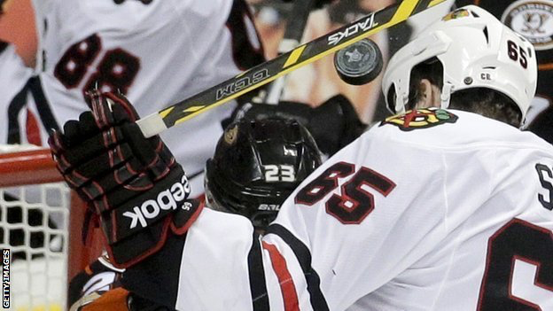
Goals
Given a set of data for two or more groups derived from high throughput sequencing
Is the composition of the groups different?
What are the univariate differences between the groups?
What correlates with what?
Notes:
Many more fragments than we can count

Slide 30
Is the composition of the groups different?
Beta-diversity metrics
Unifrac
Bray-Curtis
Aitchison
Tools
Clustering
PCoA, PCA
perMANOVA
ANOSIM
MiRKAT
“researchers’ choices of a proximity measure, as well as possible transformations of the initial data, are usually governed by their prior education, the school of thought they happen to follow, and the literature they are emulating, rather than an insight into the properties of the measure itself. “
(Michael Greenacre, Author Multivariate Analysis of Ecological Data)
Notes:
Many more fragments than we can count

Slide 31
What are the univariate differences between them?
Which OTUs or genes differ between groups?
Metastats
LEfSe
ALDEx2
ANCOM
Standard
Notes:
Many more fragments than we can count

Slide 32
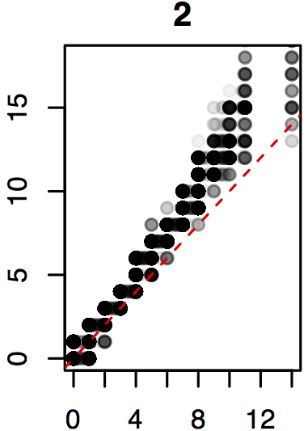
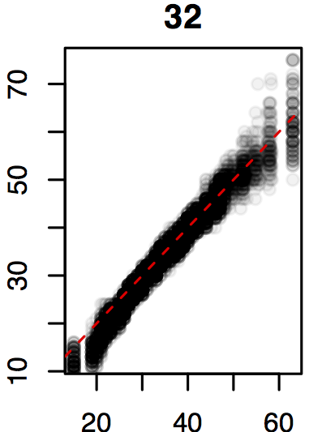
Real sequence data are variable
Count = 2
Count = 32
Same features from same samples from the same library
Sequenced on different lanes
We should get comparable answers regardless of when, where, how we sequence
We can estimate the variability by sampling Dirichlet or random multinomial instances
Dirichlet inferred
Observed
Observed
(Marioni et al, Genome Res 2008)
Notes:
Many more fragments than we can count

Slide 33
Technical replication
Normalized counts
CLR

Slide 34
Find test values not affected by random sampling in the correct space
Group 1 Group 2
ALDEx2
Generate posterior estimates of the data consistent with the observed data and the chosen prior(s)
Dirichlet instances
clr transform instances
Calculate univariate test values on each instance
Correct for FDR
Report the expected value of each test across instances
Fernandes PLoS One 2013
Macklaim Microbiome 2013
Fernandes Microbiome 2014
McMurrough PNAS 2014
Goneau mBio 2015
McMillan under review
Notes:
Many more fragments than we can count

Slide 35
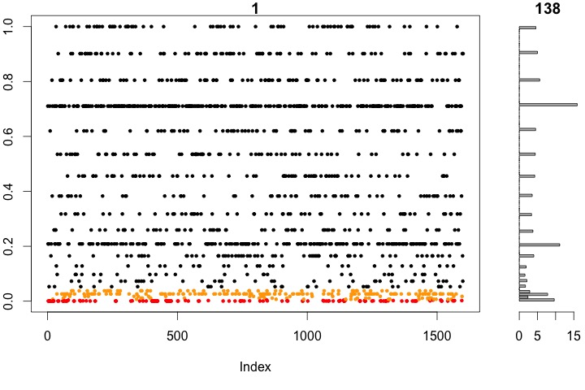
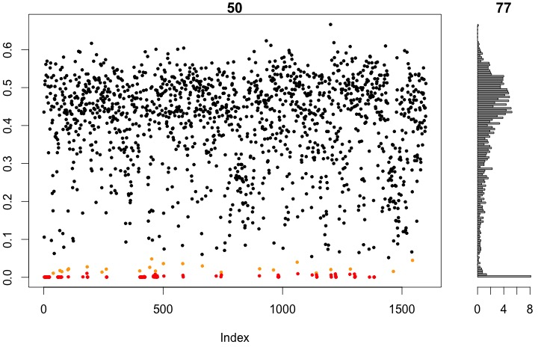
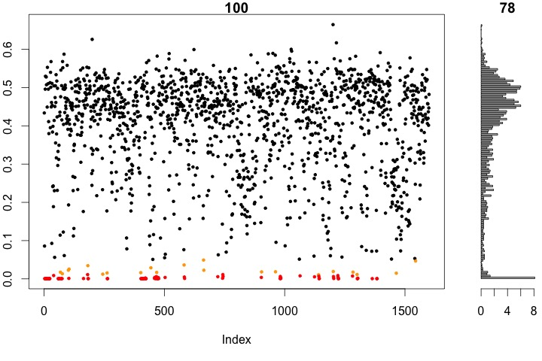
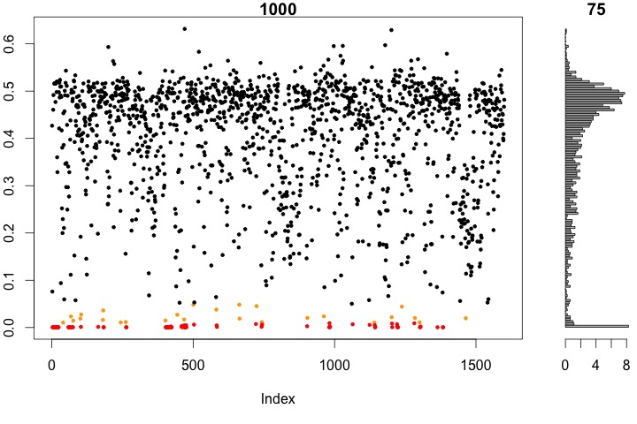
P values are unstable
BH < 0.05
138
BH < 0.05
77
1 Dirichlet instance
50 Dirichlet instances
BH < 0.05
78
BH < 0.05
75
100 Dirichlet instances
1000 Dirichlet instances
Notes:
Many more fragments than we can count

Slide 36
The effect-size plot
Plot of Within : Between group difference
Convenient way to summarize univarite differences in multivariate data
X axis - maximum variation within either group for each feature
Y axis – Difference between groups for each feature
Lines indicate effect size boundaries
D=1, V=2 E=0.5
D=1 V=0.5 E=2
D=2 V=2 E=1
Read the plot in sectors
Most 16S rRNA sequencing experiments have E<1
Notes:
Many more fragments than we can count

Slide 37
What are the correlations between features?
ReBoot
SparCC
Phi metric
Traditional
While “differential expression” of relative abundances is challenging to interpret, in the absence of any other information or assumptions, correlation of relative abundances is just wrong
Lovell et. Al. PLoS Computational Biology 2015, DOI:10.1371/journal.pcbi.1004075
Notes:
Many more fragments than we can count

Slide 38
The problem is geometrical
Any correlation that is reported must go through the origin to be real
The ratio of the parts is the only thing that can be observed
Notes:
Many more fragments than we can count

Slide 39
The problem is …
Do we do correlations on counts?
Or normalized data (proportions)?
Lovell, PLoS Comp. Bio. 2015
Notes:
Many more fragments than we can count

Slide 40
The problem is …
What if we remove some members from the group?
Lovell, PLoS Comp. Bio. 2015
Notes:
Many more fragments than we can count

Slide 41
The solution is …
Measuring constant ratios of components
Phi(x,y) statistic var(clr(x)/clr(y)) / var(clr(x))
Lovell, PLoS Comp. Bio. 2015
Notes:
Many more fragments than we can count

Slide 42
Autism?
Primary literature
Veillonellaceae (ranging between an implied mean count of 0-5 per sample) (Kang et al., 2013)
Clostridium methylpentosum (ranging between an implied mean count of 0.5-1.5) (De Angelis et al., 2013)
Unknown Bacteroidia (ranging between an implied mean count of 0.5-1.5) (Hsiao et al., 2013)
Unknown Erysipelotrichales (ranging between an implied proportion of 0 and 0.003 with no read count information available) de Theije et al. (2014)

Slide 43
Autism?
Raw Data not available
Veillonellaceae (ranging between an implied mean count of 0-5 per sample) (Kang et al., 2013)
Clostridium methylpentosum (ranging between an implied mean count of 0.5-1.5) (De Angelis et al., 2013)
Unknown Bacteroidia (ranging between an implied mean count of 0.5-1.5) (Hsiao et al., 2013)
Unknown Erysipelotrichales (ranging between an implied proportion of 0 and 0.003 with no read count information available) de Theije et al. (2014)

Slide 44
Autism?
Raw Data not available
Univariate differences
Veillonellaceae (ranging between an implied mean count of 0-5 per sample) (Kang et al., 2013)
Clostridium methylpentosum (ranging between an implied mean count of 0.5-1.5) (De Angelis et al., 2013)
Unknown Bacteroidia (ranging between an implied mean count of 0.5-1.5) (Hsiao et al., 2013)
Unknown Erysipelotrichales (ranging between an implied proportion of 0 and 0.003 with no read count information available) de Theije et al. (2014)

Slide 45
Autism?
Raw Data not available
Univariate differences
Veillonellaceae (ranging between an implied mean count of 0-5 per sample) (Kang et al., 2013)
Clostridium methylpentosum (ranging between an implied mean count of 0.5-1.5) (De Angelis et al., 2013)
Unknown Bacteroidia (ranging between an implied mean count of 0.5-1.5) (Hsiao et al., 2013)
Unknown Erysipelotrichales (ranging between an implied proportion of 0 and 0.003 with no read count information available) de Theije et al. (2014)
Applying compositional approach and accounting for variation and using False Discovery Rate -> no significantly different OTUs

Slide 46
Autism?
Raw Data not available
Univariate differences
Veillonellaceae (ranging between an implied mean count of 0-5 per sample) (Kang et al., 2013)
Clostridium methylpentosum (ranging between an implied mean count of 0.5-1.5) (De Angelis et al., 2013)
Unknown Bacteroidia (ranging between an implied mean count of 0.5-1.5) (Hsiao et al., 2013)
Unknown Erysipelotrichales (ranging between an implied proportion of 0 and 0.003 with no read count information available) de Theije et al. (2014)
Applying compositional approach and accounting for False Discovery Rate -> no significantly different OTUs
Multivariate differences

Slide 47
Autism?
Raw Data not available
Univariate differences
Veillonellaceae (ranging between an implied mean count of 0-5 per sample) (Kang et al., 2013)
Clostridium methylpentosum (ranging between an implied mean count of 0.5-1.5) (De Angelis et al., 2013)
Unknown Bacteroidia (ranging between an implied mean count of 0.5-1.5) (Hsiao et al., 2013)
Unknown Erysipelotrichales (ranging between an implied proportion of 0 and 0.003 with no read count information available) de Theije et al. (2014)
Applying compositional approach and accounting for False Discovery Rate -> no significantly different OTUs
Multivariate differences
Small sample sizes
Only one rarefaction shown (Unifrac varies)
Sub-composition compared (Unifrac varies)

Slide 48
Autism?
Raw Data not available
Univariate differences
Veillonellaceae (ranging between an implied mean count of 0-5 per sample) (Kang et al., 2013)
Clostridium methylpentosum (ranging between an implied mean count of 0.5-1.5) (De Angelis et al., 2013)
Unknown Bacteroidia (ranging between an implied mean count of 0.5-1.5) (Hsiao et al., 2013)
Unknown Erysipelotrichales (ranging between an implied proportion of 0 and 0.003 with no read count information available) de Theije et al. (2014)
Applying compositional approach and accounting for False Discovery Rate -> no significantly different OTUs
All studies use similar approaches and have same pitfalls
Analysis methods not robust to sub-compositions
Rare OTUs often most “significant”
-these are the least robust to random sampling
Similar story for many other conditions
Multivariate differences
Small sample sizes
Only one rarefaction shown (Unifrac varies)
Sub-composition compared (Unifrac varies)

Slide 49
Correlations?
Kang, PLoS ONE 2013

Slide 50
But recall …

Slide 51
Conclusions
Sequencing is not counting
Machine capacity imposes constant sum constraint
High throughput sequencing datasets have significant variation
Variation is proportionally more extreme at low count margins
Modeling and accounting for this variation combined with placing data in the proper space reduces false positive identifications when conducting tests
There are tools out there, we need to get rid of the black box
Notes:
Many more fragments than we can count

Slide 52
Recommendations
We all must improve our understanding of the entire process
Eliminate black box or “checklist” experiments
Compositional data is more complex and we need more care
We need to remember the variation in the entire process
Editors and Journals need to change
We need to report our raw data
Reads, should be deposited
Software & workflow should be supplementary or in a release
Table of counts should be supplementary
Effect sizes are generally small
Increase sample sizes whenever possible
Know the limitations of small sample sizes
We need to use appropriate tools
Bray Curtis, Aitchison distance are generally more stable distance metrics for multivariate analyses
ALDEx2 approach is most appropriate for univariate differences
Phi is the compositionally most appropriate measure of correlation
Notes:
Many more fragments than we can count

Slide 53

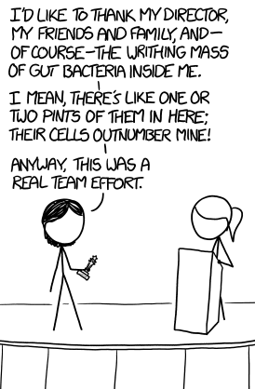
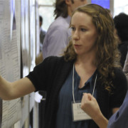

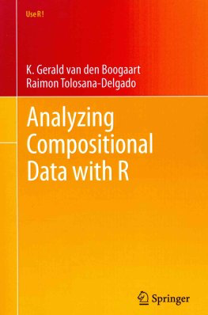

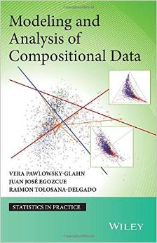
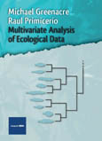


Acknowledgments / Sources
Notes:
Many more fragments than we can count

